Slide 1
Cleansing the Sanctuary
By Robert Melashenko

Slide 2
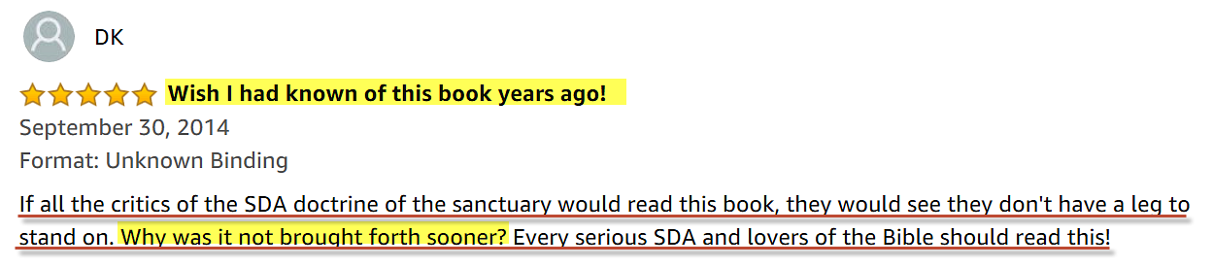

Would this review interest you?

Slide 3
Do not ye yet understand, that whatsoever entereth in at the mouth goeth into the belly, and is cast out into the draught? But those things which proceed out of the mouth come forth from the heart; and they defile the man. For out of the heart proceed evil thoughts, murders, adulteries, fornications, thefts, false witness, blasphemies: These are the things which defile a man: but to eat with unwashen hands defileth not a man.
(Mat 15:17-20 KJV)

Slide 4
The heart is deceitful above all things, and desperately wicked: who can know it?
(Jer 17:9)

Slide 5
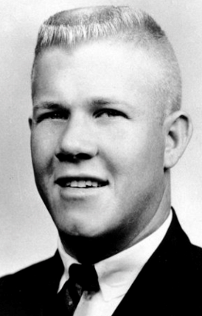
Thought Experiment

Slide 6
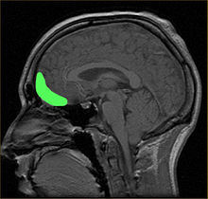

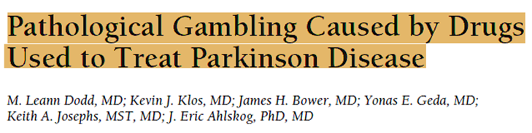
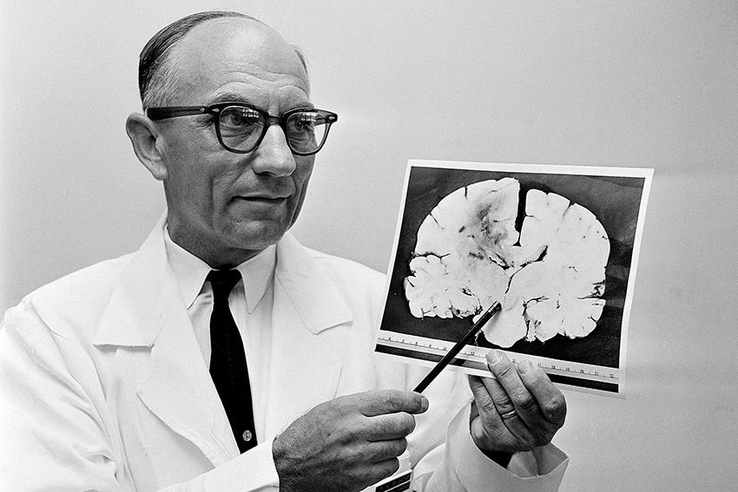
The Answers

Slide 7
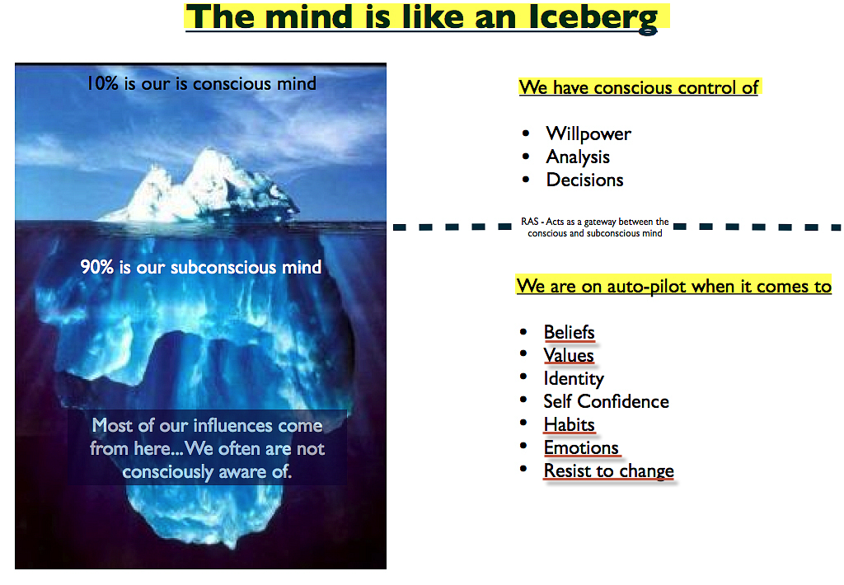

Slide 8
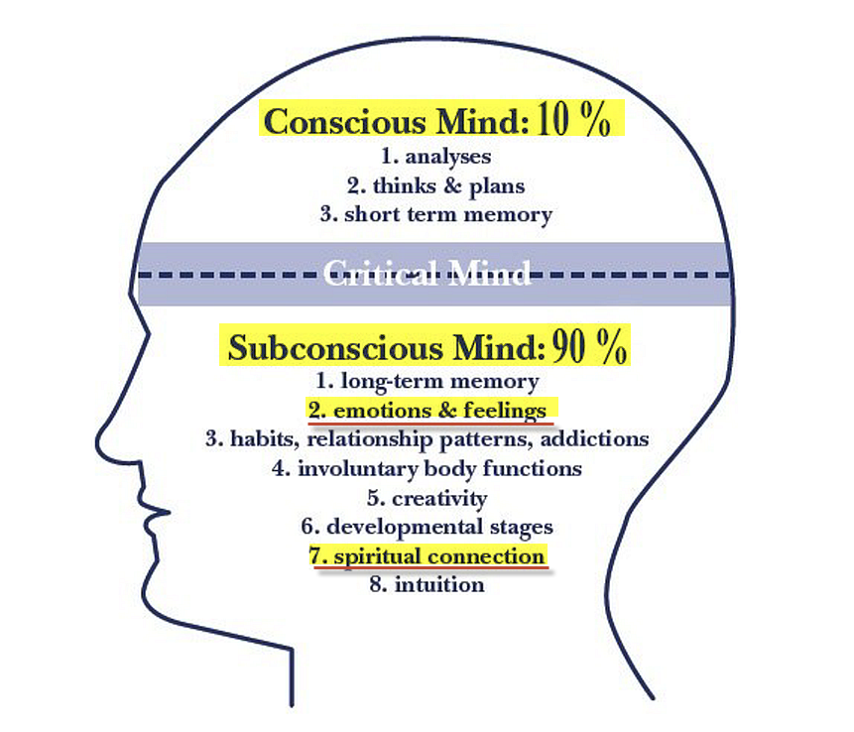
The Subconscious Mind

Slide 9
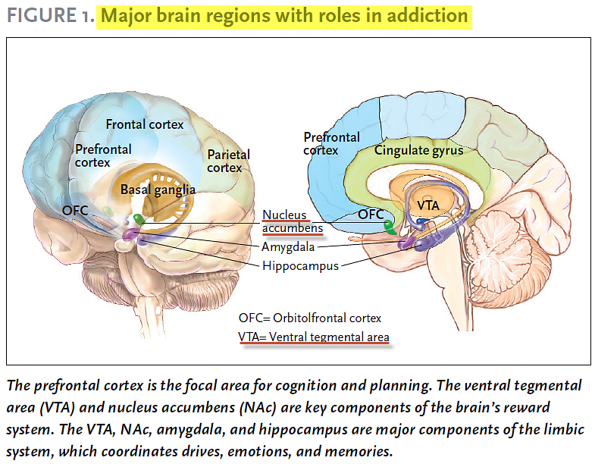
SCIENCE & PRACTICE PERSPECTIVES — APRIL 2007

Slide 10
THE TREE OF KNOWLEDGE
OF
GOOD AND EVIL

Slide 11
Seeing then that the unconscious processes play so large a part in our mental life and in our conduct, and realizing that so much evil lies in the depths, theologians have very naturally asked how far redemptive processes as preached in the Gospel of Christ can affect the unconscious. Does the acceptance of modern psychological theories lead to the conclusion that religious life is concerned only with the conscious mind, and that a very large part of human personality is left untouched and unchanged? Are we also to infer that the Christian must remain in a state where much of his being is in rebellion against God, or is alien to God?
Ernest White, Christian Life and the Unconscious, New York, 1955, p. 20.
Cited in - Then Shall the Sanctuary be Cleansed. By Donald K. Short. Chapt. 5

Slide 12
The answer for a Seventh-day Adventist is that all rebellion and everything that is alien to God must be eradicated from the heart before anyone can stand in God’s presence. This means that even the unconscious mind must be cleansed before the final generation is ready for translation.
Donald K. Short, Then Shall the Sanctuary be Cleansed. Chapt. 5

Slide 13
And Jehovah saw that the evil of man was great on the earth, and every imagination (framework) of the thoughts of his heart was only evil all the day long. (Gen 6:5 LITV)
What God says 2 verses prior (V3) now make sense.
And the LORD said, My spirit shall not always strive (plead) with man, for that he also is flesh: yet his days shall be an hundred and twenty years. (Gen 6:3 KJV)

Slide 14
Reins or Kidneys
Examine me, O LORD, and prove me; try (refine) my reins and my heart. (Psa 26:2) RV
I will bless the LORD, who hath given me counsel: yea, my reins instruct me in the night seasons.
(Psa 16:7)

Slide 15
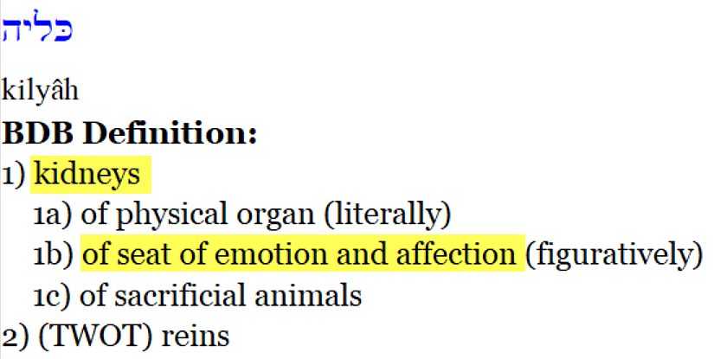
H3629
Brown-Driver-Briggs – Hebrew Definitions
The remaining nine references all use kidneys as a symbol of the inner most being. This is probably so since in dismembering an animal the kidneys are the last organ to be reached. In this usage it is frequently paralleled with heart (as it is at least once in Ugaritic). Jeremiah seems to be emphasizing this innermost idea when he says that the religion of the wicked is superficial, on their lips, but far from their kidneys (Jer_12:2). Five times in Jeremiah and Psalms the importance of inner religion is stressed when it is said that God tries the heart and the kidneys (Jer_11:20). (Theological Wordbook of the Old Testament)

Slide 16
Which Parts of the Sacrifice was burned?
Animals given for the peace, sin, and trespass offerings, as well as those offered for consecration of the priests, were to have the internal fat, the kidneys, and the caul above the liver removed and burned on the altar (Exo_29:13, Exo_29:22; Lev_3:4, Lev_3:10, Lev_3:15; Lev_4:9; Lev_7:4; Lev_8:16, Lev_8:25; Lev_9:10, Lev_9:19).
(Theological Wordbook of the Old Testament)

Slide 17
The common idea that the burning either of part or the whole of the sacrifice pointed to its destruction, and symbolized the wrath of God and the punishment due to sin, does not seem to accord with the statements of Scripture. The term used is not that commonly employed for burning, but means ‘causing to smoke,’ and the rite symbolizes partly the entire surrender of the sacrifice, but chiefly its acceptance on the part of God.
The Temple—Its Ministry and Services. Chapt: Sacrifices. Alfred Edersheim

Slide 18
This explains an important fact about Jesus.
Born with sinful flesh (MGE’s), how could He live a perfect life in childhood?
For thou hast possessed my reins: thou hast covered me in my mother's womb. (Psa 139:13 KJV)

Slide 19
Believest thou not that I am in the Father, and the Father in me? the words that I speak unto you I speak not of myself: but the Father that dwelleth in me, he doeth the works.
(Joh 14:10 KJV)

Slide 20
Thy word have I hid in mine heart, that I might not sin against thee.
(Psa 119:11 KJV)

Slide 21
Let this mind be in you, which was also in Christ Jesus:
(Php 2:5 KJV)

Slide 22
For if after they have escaped the pollutions of the world through the knowledge of the Lord and Saviour Jesus Christ, they are again entangled therein, and overcome, the latter end is worse with them than the beginning. For it had been better for them not to have known the way of righteousness, than, after they have known it, to turn from the holy commandment delivered unto them.
(2Peter 2:20-21 KJV)

Slide 23
When the unclean spirit is gone out of a man, he walketh through dry places, seeking rest; and finding none, he saith, I will return unto my house whence I came out. And when he cometh, he findeth it swept and garnished. Then goeth he, and taketh to him seven other spirits more wicked than himself; and they enter in, and dwell there: and the last state of that man is worse than the first. (Luke 11:24-26 KJV)

Slide 24
Gotta Serve Somebody
Written by: Bob Dylan
You may be an ambassador to England or France
You may like to gamble, you might like to dance
You may be the heavyweight champion of the world
You may be a socialite with a long string of pearls
But you’re gonna have to serve somebody, yes indeed
You’re gonna have to serve somebody
Well, it may be the devil or it may be the Lord
But you’re gonna have to serve somebody

Slide 25
And be not conformed to this world: but be ye transformed by the renewing of your mind, that ye may prove what is that good, and acceptable, and perfect, will of God.
(Rom 12:2 KJV)
Do not conform yourselves to the standards of this world, but let God transform you inwardly by a complete change of your mind. Then you will be able to know the will of God—what is good and is pleasing to him and is perfect.
(Rom 12:2 GNB)

Slide 26
So get rid of your old self, which made you live as you used to—the old self that was being destroyed by its deceitful desires. Your hearts and minds must be made completely new, and you must put on the new self, which is created in God's likeness and reveals itself in the true life that is upright and holy.
(Eph 4:22-24 GNB)

Slide 27
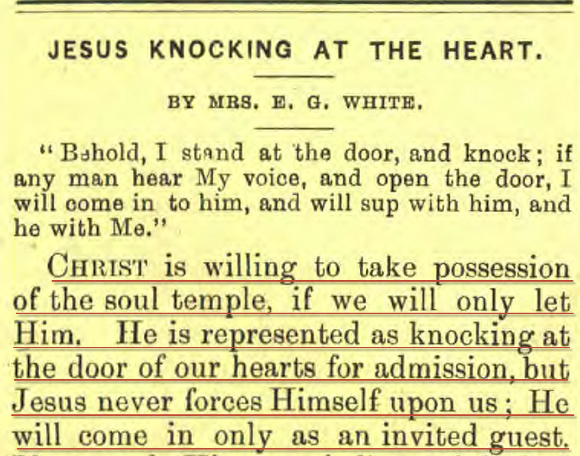
Present Truth, April 24, 1890.

Slide 28
And what agreement hath the temple of God with idols? for ye are the temple of the living God; as God hath said, I will dwell in them, and walk in them; and I will be their God, and they shall be my people. (2Co 6:16 KJV)
Jesus answered and said unto him, If a man love me, he will keep my words: and my Father will love him, and we will come unto him, and make our abode with him. (Joh 14:23 KJV)

Slide 29
When God thinks for a man it is not like one man’s thinking for and imposing his will on another. There is perfect freedom. The man chooses God’s thoughts, because they are better than his own, and then God thinks in him, the man’s brain being the organ of the Holy Spirit. “For ye have not received the spirit of bondage again to fear” (Rom. 8:15), but God has given us the Spirit “of power and of love and of a sound mind.”(2 Tim. 1:7). Only by the Spirit of God can anybody rightly know anything.(1 Cor. 2:12). When men submit to be the temples of God, then is God's will done on earth even as it is done in heaven.
(E. J. Waggoner. The Sanctuary of God)

Slide 30
(For the weapons of our warfare are not carnal, but mighty through God to the pulling down of strong holds;) Casting down imaginations, and every high thing that exalteth itself against the knowledge of God, and bringing into captivity every thought to the obedience of Christ;
(2Co 10:4-5 KJV)

Slide 31
But we preach Christ crucified, unto the Jews a stumblingblock, and unto the Greeks foolishness; (1Cor 1:23 KJV)
Christ crucified — The Greek expresses not the mere fact of His crucifixion, but the permanent character acquired by the transaction –
Jamieson – Fausset – Brown Commentary

Slide 32
Now therefore ye are no more strangers and foreigners, but fellowcitizens with the saints, and of the household of God; And are built upon the foundation of the apostles and prophets, Jesus Christ himself being the chief corner stone; In whom all the building fitly framed together groweth unto an holy temple in the Lord: In whom ye also are builded together for an habitation of God through the Spirit.
(Eph 2:19-22 KJV)

Slide 34
Let this mind be in you, which was also in Christ Jesus:
(Php 2:5 KJV)

Slide 35
Gotta Serve Somebody - cont
You may be a preacher with your spiritual pride
You may be a city councilman taking bribes on the side
You may be workin’ in a barbershop, you may know how to cut hair
You may be somebody’s mistress, may be somebody’s heir
But you’re gonna have to serve somebody, yes indeed
You’re gonna have to serve somebody
Well, it may be the devil or it may be the Lord
But you’re gonna have to serve somebody

